Slide 1
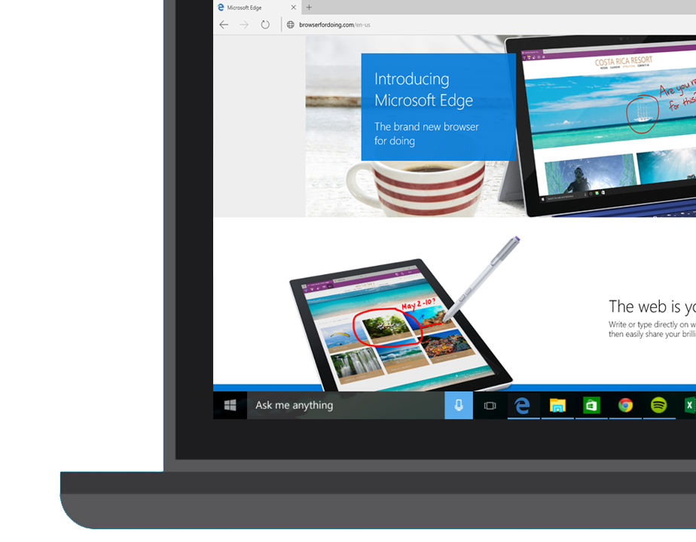
Microsoft Edge and Web App Platform Windows 10 Developer Workshop

Slide 2
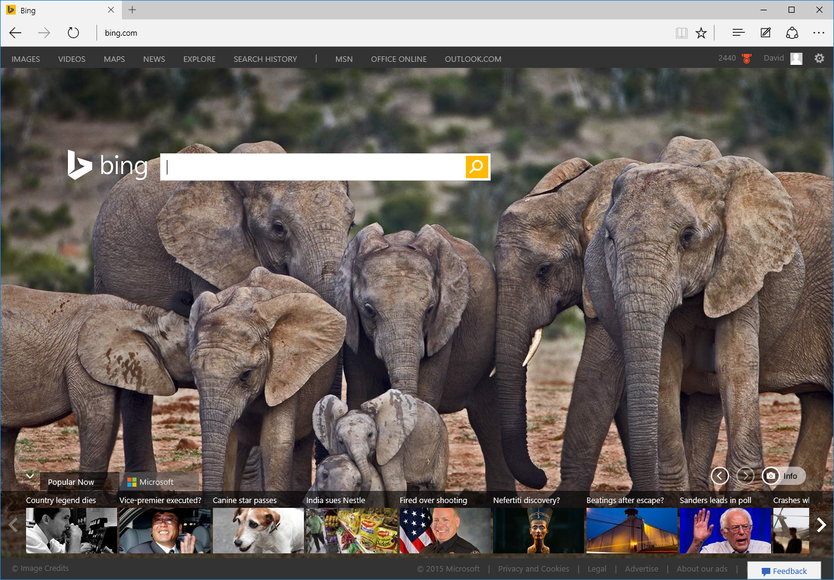
IntroducingMicrosoft Edge
Notes:
So now to the present day and the introduction of Microsoft Edge.

Slide 3

Always up-to-date
EdgeHTML
Chakra
EdgeHTML
Chakra
Notes:
The big difference with Microsoft Edge is that it has an engine that is always up to date.
IE11 will still be available for those cases where you need to access legacy web content, or for sites that use plug-ins such as ActiveX or Silverlight.
But for the modern web, for the most up to date features such as HTML5, ECMAScript 6 and CSS3 or 4, you’ll want to use Edge.
And we will always keep it up to date – we call it ‘Evergreen’.
So this makes things easier for the web developer. If you want to develop for the web, you just need to target the latest versions of Firefox, Chrome, Opera and Edge

Slide 4
Performances
Notes:
In Edge, we did tremendous work on the Chakra JavaScript engine which yielded tremendous performance.
Here is how EdgeHTML performs on two leading web benchmarks:
<click>
On the JetStream benchmark created by Apple, which simulates complex web applications, EdgeHTML is over 1.5x faster than IE11.
<click>
Beyond that, it is also ahead of the latest 64-bit browsers.

Slide 5
Performances
Notes:
Next on the Octane benchmark, created by Google, Edge is over twice as fast as IE11
<click>
And again, Edge, leapfrogs into the lead ahead of other 64-bit browsers.
Our work is not done, but we feel great that Edge will provide industry leading performance out of the gate.

Slide 6




User-Agent Strings
Mozilla/5.0 (Windows NT 10.0; WOW64; rv:35.0) Gecko/20100101 Firefox/35.0
Mozilla/5.0 (Macintosh; Intel Mac OS X 10_10_1) AppleWebKit/600.1.25 (KHTML, like Gecko) Version/8.0 Safari/600.1.25
Mozilla/5.0 (Windows NT 10.0; WOW64) AppleWebKit/537.36 (KHTML, like Gecko) Chrome/40.0.2214.93 Safari/537.36
Mozilla/5.0 (Windows NT 10.0; WOW64) AppleWebKit/537.36 (KHTML, like Gecko) Chrome/39.0.2171.71 Safari/537.36 Edge/12.0

Slide 7
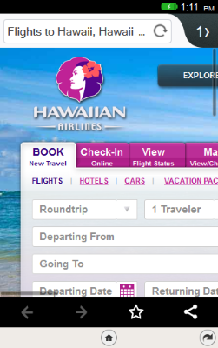
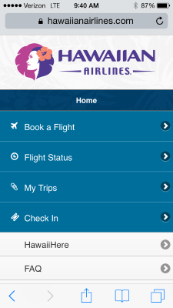
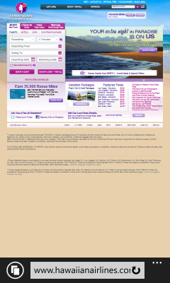


Slide 8
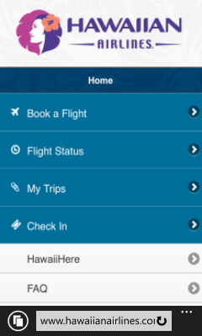


Slide 9

Microsoft EdgeHTML
Microsoft Edge
JS Symbols
ES6 Numbers Built-Ins
DOM L3 XPath
Rest parameters
4200+ interoperability improvements
ES6 Template Strings
Arrow function
asm.js
JS iterators
<img srcset>
Web Audio API
ES6 classes
GamePad API
Content Security Policy
Video tracks
ES6 Promises
Selection API
ES6 Math Built-Ins
HTTP Strict Transport Security
Touch Events
Media Queries L4 Interaction Media
ES6 String Built-Ins
ES6 WeakSet
getUserMedia()
ES6 Spread
preserve-3d
ES6 Proxies
ES6 Object Built-Ins
HTTP/2
WAV audio
HTTP Live Streaming
Date <input> types
Motion JPEG
Generators

Slide 10
Windows Web Platform

Slide 11
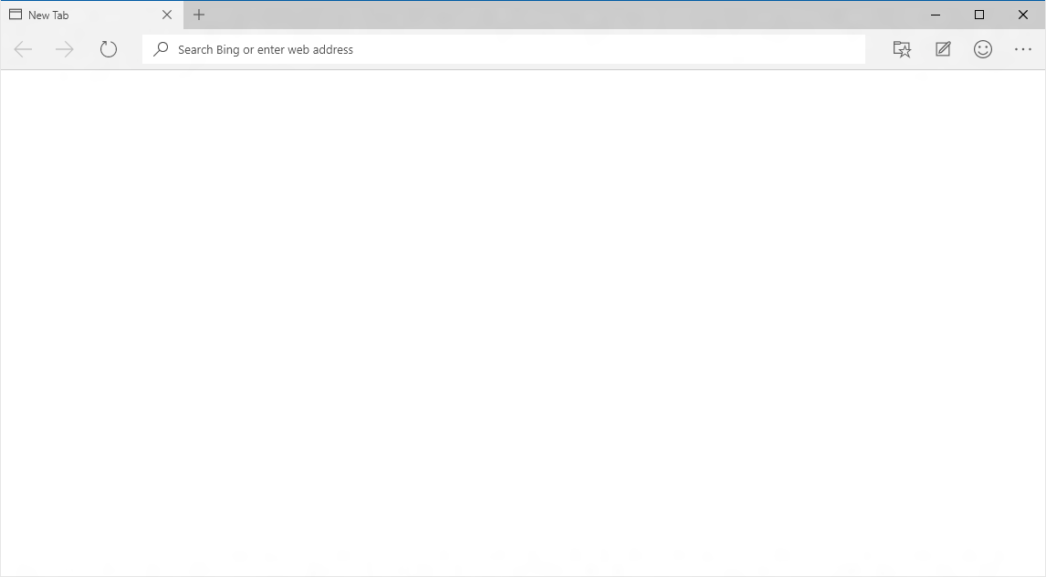
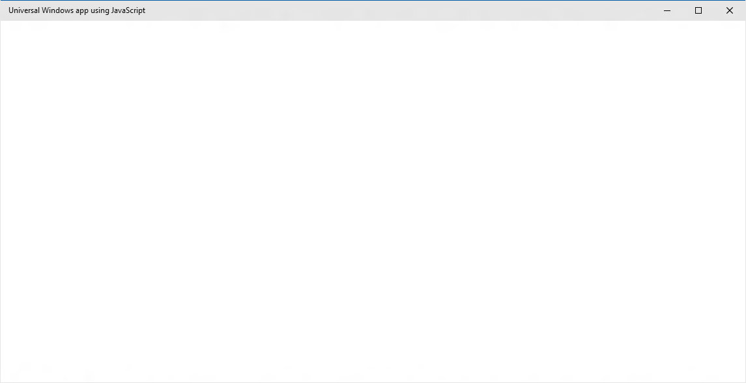
EdgeHTML.dll
Chakra
Packaged content
Offline first
Hosted content
Always up-to-date
WebView

Slide 12
Packaged content
Offline first

Slide 13
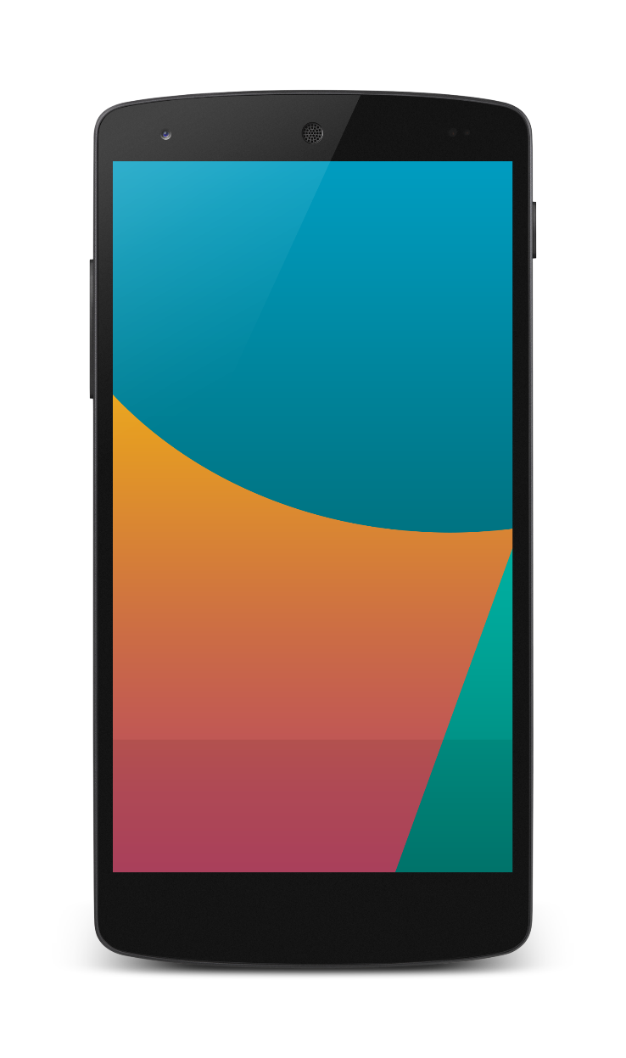
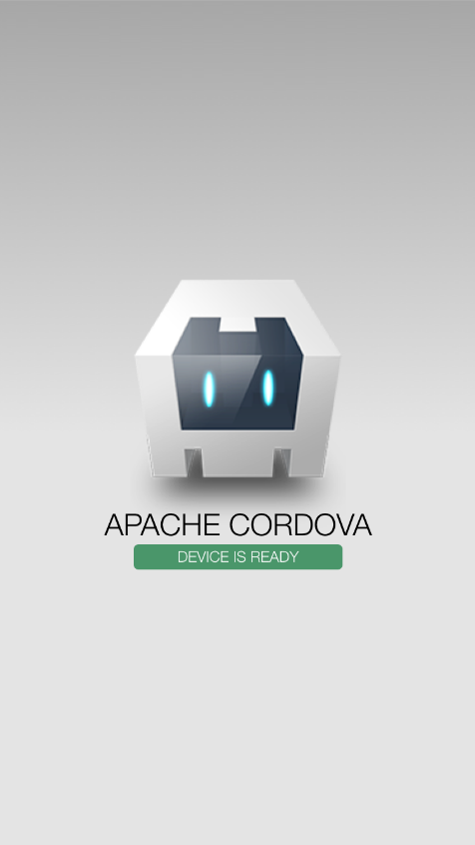

Packaged apps and tools investments
Build apps for iOS, Android & Windows
Nearly 100% shared code
Debug on any device or emulator
Use the JavaScript frameworks you love
Support for offline

Slide 14
WebView

Slide 15
WebView Control
Uses the always current Edge rendering engine
Improved app performance and responsiveness
Improved App to WebView communication
Enables Windows Runtime access

Slide 16
Lab: Webview

Slide 17
Hosted content
Always up-to-date

Slide 18
Microsoft Edge
NEW: Hosted Web Apps
Bring your website experience to the Windows Store
Leverage your web investments and developer workflow
Full access to Universal APIs like
Tiles, Notifications, Camera, Contact List, Calendar
.appx
HTML
CSS
JS
Universal Windows Platform

Slide 19
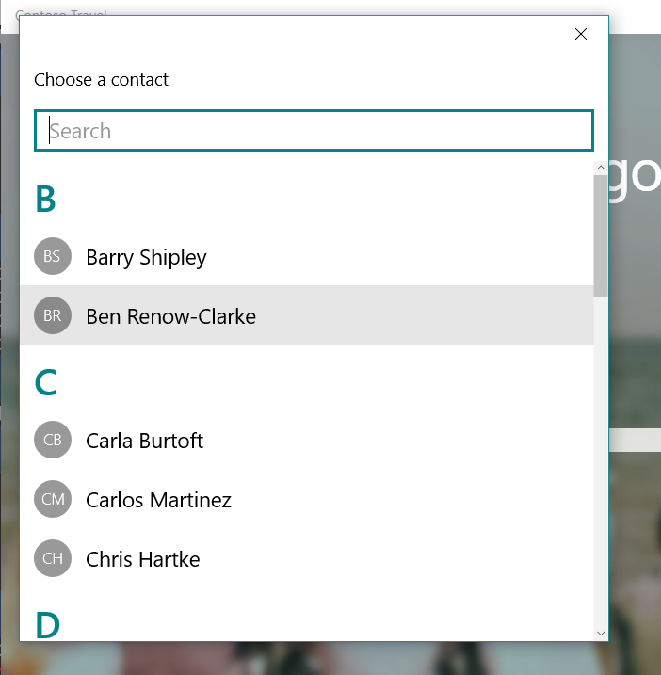
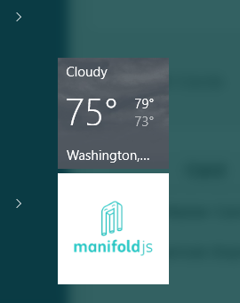
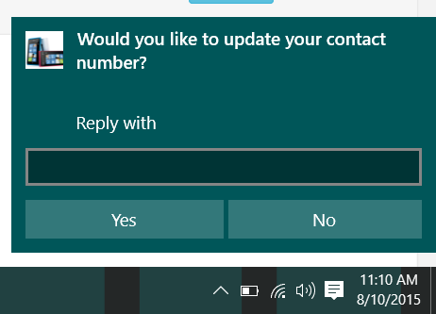
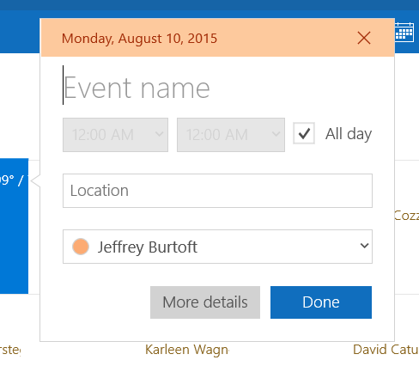
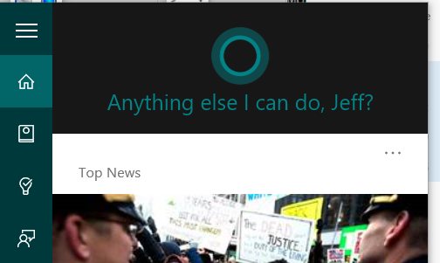
Windows APIs

Slide 20
Lab: Hosted Web Apps

Slide 21
W3C Standard
{
"name": "Super Web App",
"short_name": "SuperWA",
"start_url": "http://www.example.com",
"icons": [
{
"src": "tiny.png",
"sizes": "70x70"
},
{
"src": "square.png",
"sizes": "150x150"
},
{
"src": "apple-touch-icon-72x72-precomposed.png",
"sizes": "72x72"
},
{
"src": "niceicon.png",
"sizes": "128x128"
}
],
"display": "standalone",
"orientation": "landscape"
}
Manifest for Web Apps
http://w3c.github.io/manifest/

Slide 22
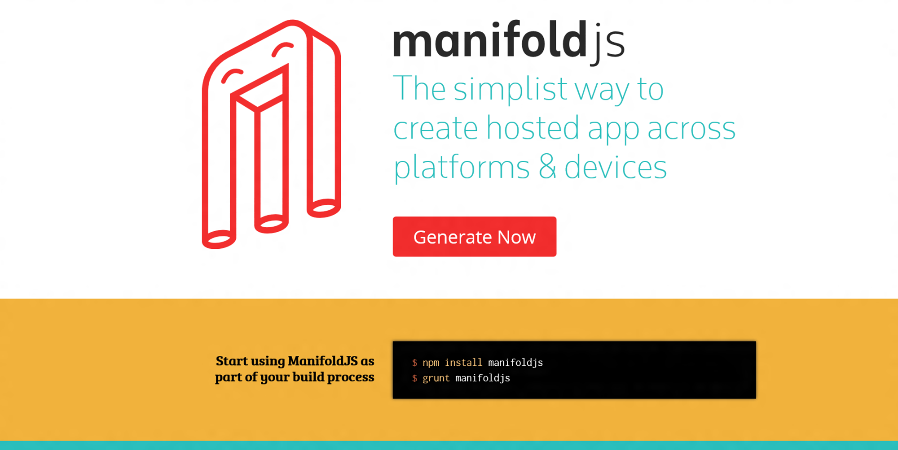

Slide 23
DEMO ManifoldJS

